Slide 1

Python Functions
Introduction to Programming
Comp07027
Lecture 8: Python Functions (2)
Dr Muhammad Aslam
Lecturer UWS Wuxi
Muhammad.Aslam@uws.ac.uk

Slide 2
User-defined function
Functions which are created by programmer explicitly according to the requirement are called a user-defined function.
Creating a Function
Use the following steps to define a function in Python.
Use the def keyword with the function name to define a function.
Next, pass the number of parameters as per your requirement. (Optional).
Next, define the function body with a block of code. This block of code is nothing but the action you wanted to perform.
In Python, no need to specify curly braces for the function body. The only indentation is essential to separate code blocks. Otherwise, you will get an error.

Slide 3
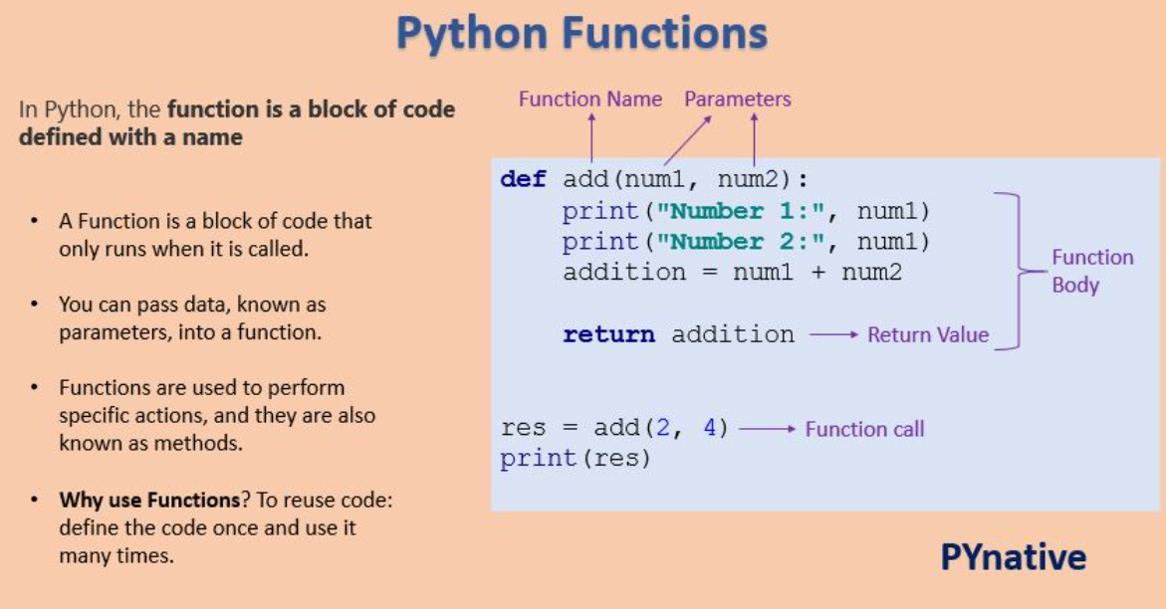
Function Basic Flowchart

Slide 4
Local Variable in function
A local variable is a variable declared inside the function that is not accessible from outside of the function. The scope of the local variable is limited to that function only where it is declared.
If we try to access the local variable from the outside of the function, we will get the error as NameError.
def function1(): # local variable loc_var = 888 print("Value is :", loc_var) def function2(): print("Value is :", loc_var) function1() function2()

Slide 5
Example: Global Keyword in Function
# Global variable global_var = 5 def function1(): print("Value in 1st function :", global_var) def function2(): # Modify global variable # function will treat it as a local variable global_var = 44 print("Value in 2nd function :", global_var) def function3(): print("Value in 3rd function :", global_var) function1() function2() function3()
As you can see, function2() treated global_var as a new variable (local variable). To solve such issues or access/modify global variables inside a function, we use the global keyword.

Slide 6
Nested Function
Python supports the concept of a "nested function" or "inner function", which is simply a function defined inside another function.
The inner function can access the variables within the enclosing scope.
Defining an Inner Function
To define an inner function in Python, we simply create a function inside another function using the Python's def keyword. Here is an example:
def function1(): # outer function print ("Hello from outer function") def function2(): # inner function print ("Hello from inner function") function2() function1()

Slide 7
Outer Function call for Nested Function
It is important to mention that the outer function must be called for the inner function to execute.
If the outer function is not called, the inner function will never execute. To demonstrate this, modify the above code to the following and run it:
def function1(): # outer function print ("Hello from outer function") def function2(): # inner function print ("Hello from inner function") function2()

Slide 8
Example:Outer Function call for Nested Function
def num1(x): def num2(y): return x * y return num2 res = num1(10) print(res(5))
# output is 50
The code returns the multiplication of the two numbers, that is, 10 and 5. The example shows that an inner function is able to access variables accessible in the outer function.

Slide 9
Access of variable within Nested Function
So far, you have seen that it is possible for us to access the variables of the outer function inside the inner function. What if we attempt to change the variables of the outer function from inside the inner function? Let us see what happens:
def function1(): # outer function x = 2 # A variable defined within the outer function def function2(a): # inner function # Let's define a new variable within the inner function # rather than changing the value of x of the outer function x = 6 print (a+x) print (x) # to display the value of x of the outer function function2(3) function1()
The output shows that it is possible for us to display the value of a variable defined within the outer function from the inner function, but not change it. The statement x = 6 helped us create a new variable x inside the inner function function2() rather than changing the value of variable x defined in the outer function function1() .

Slide 10
Nonlocal Variable in Function
In Python, nonlocal is the keyword used to declare a variable that acts as a global variable for a nested function (i.e., function within another function).
We can use a nonlocal keyword when we want to declare a variable in the local scope but act as a global scope.
def outer_func(): x = 777 def inner_func(): # local variable now acts as global variable nonlocal x x = 7000 print("value of x inside inner function is :", x) inner_func() print("value of x inside outer function is :", x) outer_func()

Slide 11
Python Function Arguments
The argument is a value, a variable, or an object that we pass to a function or method call. In Python, there are four types of arguments allowed.
Positional arguments
keyword arguments
Default arguments
Variable-length arguments

Slide 12
Positional Arguments
Positional arguments are arguments that are pass to function in proper positional order.
That is, the 1st positional argument needs to be 1st when the function is called. The 2nd positional argument needs to be 2nd when the function is called, etc.
See the following example for more understanding.
def add(a, b): print(a - b) add(50, 10) # Output 40 add(10, 50) # Output -40
If you try to use pass more parameters you will get an error.
add(50, 10, 30)

Slide 13
Keyword Arguments
A keyword argument is an argument value, passed to function preceded by the variable name and an equals sign.
def message(name, surname): print("Hello", name, surname) message(name="John", surname="Wilson") message(surname="Ault", name="Kelly")
In keyword arguments order of argument is not matter, but the number of arguments must match. Otherwise, we will get an error.

Slide 14
Example: Keyword Arguments
While using keyword and positional argument simultaneously, we need to pass 1st arguments as positional arguments and then keyword arguments.
Otherwise, we will get SyntaxError. See the following example.
def message(first_nm, last_nm): print("Hello..!", first_nm, last_nm) # correct use message("John", "Wilson") message("John", last_nm="Wilson") # Error # SyntaxError: positional argument follows keyword argument message(first_nm="John", "Wilson")

Slide 15
Default Arguments
Default arguments take the default value during the function call if we do not pass them.
We can assign a default value to an argument in function definition using the = assignment operator.
def message(name="Guest"): print("Hello", name) # calling function with argument message("John") # calling function without argument message()

Slide 16
Variable-length Arguments
In Python, sometimes, there is a situation where we need to pass multiple numbers of arguments to the function.
Such types of arguments are called variable-length arguments.
We can declare a variable-length argument with the * (asterisk) symbol.
def fun(*var): function body
We can pass any number of arguments to this function. Internally all these values are represented in the form of a tuple.
def addition(*numbers): total = 0 for no in numbers: total = total + no print("Sum is:", total) # 0 arguments addition() # 5 arguments addition(10, 5, 2, 5, 4) # 3 arguments addition(78, 7, 2.5)

Slide 17
Recursive Function
A recursive function is a function that calls itself, again and again.
Consider, calculating the factorial of a number is a repetitive activity, in that case, we can call a function again and again, which calculates factorial.
factorial(5)
5*factorial(4)
5*4*factorial(3)
5*4*3*factorial(2)
5*4*3*2*factorial(1)
5*4*3*2*1 = 120
def factorial(no): if no == 0: return 1 else: return no * factorial(no - 1) print("factorial of a number is:", factorial(8))

Slide 18
Recursive Function
The advantages of the recursive function are:
By using recursive, we can reduce the length of the code.
The readability of code improves due to code reduction.
Useful for solving a complex problem
The disadvantage of the recursive function:
The recursive function takes more memory and time for execution.
Debugging is not easy for the recursive function.

Slide 19
Python Anonymous/Lambda Function
Sometimes we need to declare a function without any name. The nameless property function is called an anonymous function or lambda function.
The reason behind the using anonymous function is for instant use, that is, one-time usage.
Normal function is declared using the def function. Whereas the anonymous function is declared using the lambda keyword.
In opposite to a normal function, a Python lambda function is a single expression.
But, in a lambda body, we can expand with expressions over multiple lines using parentheses or a multiline string.

Slide 20
Python Anonymous/Lambda Function
Syntax of lambda function:
lambda: argument_list:expression
When we define a function using the lambda keyword, the code is very concise so that there is more readability in the code.
A lambda function can have any number of arguments but return only one value after expression evaluation.
Let’s see an example to print even numbers without a lambda function and with a lambda function.
See the difference in line of code as well as readability of code.

Slide 21
Example 1: Program for even numbers without lambda function
#Example 1: Program for even numbers without lambda function def even_numbers(nums): even_list = [] for n in nums: if n % 2 == 0: even_list.append(n) return even_list num_list = [10, 5, 12, 78, 6, 1, 7, 9] ans = even_numbers(num_list) print("Even numbers are:", ans)

Slide 22
Example 1: Program for even numbers with a lambda function
#Example 1: Program for even numbers without lambda function def even_numbers(nums): even_list = [] for n in nums: if n % 2 == 0: even_list.append(n) return even_list num_list = [10, 5, 12, 78, 6, 1, 7, 9] ans = even_numbers(num_list) print("Even numbers are:", ans)
#Example 2: Program for even number with a lambda function l = [10, 5, 12, 78, 6, 1, 7, 9] even_nos = list(filter(lambda x: x % 2 == 0, l)) print("Even numbers are: ", even_nos)

Slide 23
filter() function in Python
In Python, the filter() function is used to return the filtered value. We use this function to filter values based on some conditions.
filter(funtion, sequence)
function – Function argument is responsible for performing condition checking.
sequence – Sequence argument can be anything like list, tuple, string
#Example: lambda function with filter() l = [-10, 5, 12, -78, 6, -1, -7, 9] positive_nos = list(filter(lambda x: x > 0, l)) print("Positive numbers are: ", positive_nos)

Slide 24
map() function in Python
In Python, the map() function is used to apply some functionality for every element present in the given sequence and generate a new series with a required modification.
Ex: for every element present in the sequence, perform cube operation and generate a new cube list.
map(function, sequence)
function – function argument responsible for applied on each element of the sequence
sequence – Sequence argument can be anything like list, tuple, string
#Example: lambda function with map() function list1 = [2, 3, 4, 8, 9] list2 = list(map(lambda x: x*x*x, list1)) print("Cube values are:", list2)

Slide 25
reduce() function in Python
In Python, the reduce() function is used to minimize sequence elements into a single value by applying the specified condition.
The reduce() function is present in the functools module; hence, we need to import it using the import statement before using it.
Syntax of reduce() function: reduce(function, sequence)
#Example: lambda function with reduce() from functools import reduce list1 = [20, 13, 4, 8, 9] add = reduce(lambda x, y: x+y, list1) print("Addition of all list elements is : ", add)

Slide 26
Questions??

